Slide 1
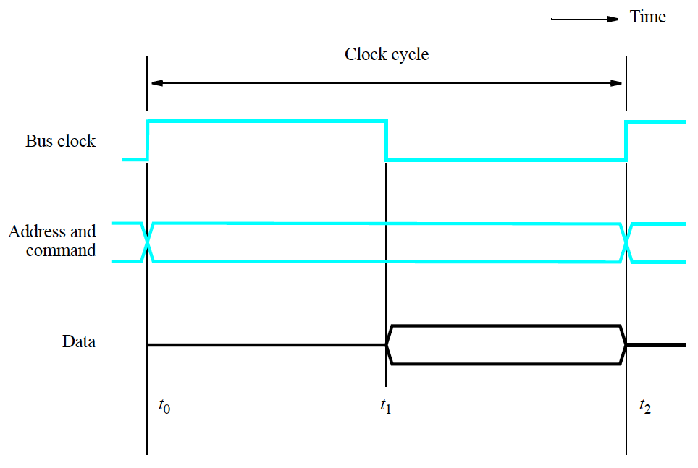
Synchronous Bus: A Read Operation
1: At t0, master places device address on address lines and Read command on control lines. Slave decodes the command and address.
1
3
1
2
2: Slave responds at t1 by putting data on data lines.
3: At t2, master reads data on the data lines and loads data into its own registers.

Slide 2
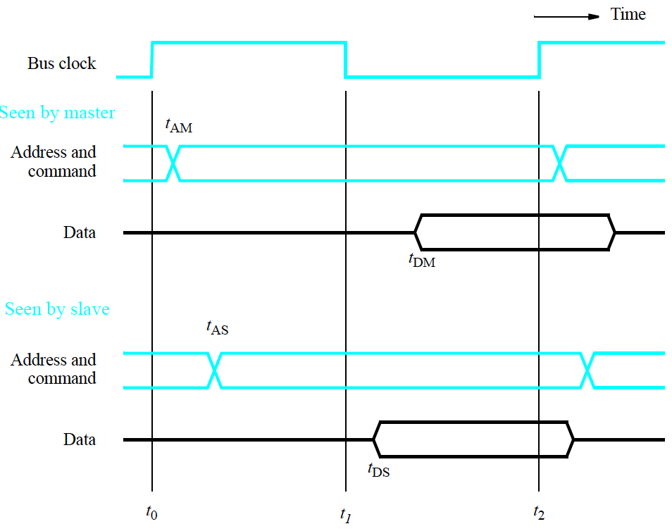
More Detailed View of Synchronous Bus
1: Master places address and command at t0 on bus. But, propagation delay in circuits results in bus seeing
these at tAM.
Must be larger than hold time
5
1
2: Signals reach slave. Notice bus delay.
4
4: Data seen on bus by master.
3: Slave decodes address and sends data at t1, but again propagation delay is experienced.
2
3
5: t2 master loads data.
t2-tDM > setup time

Slide 3
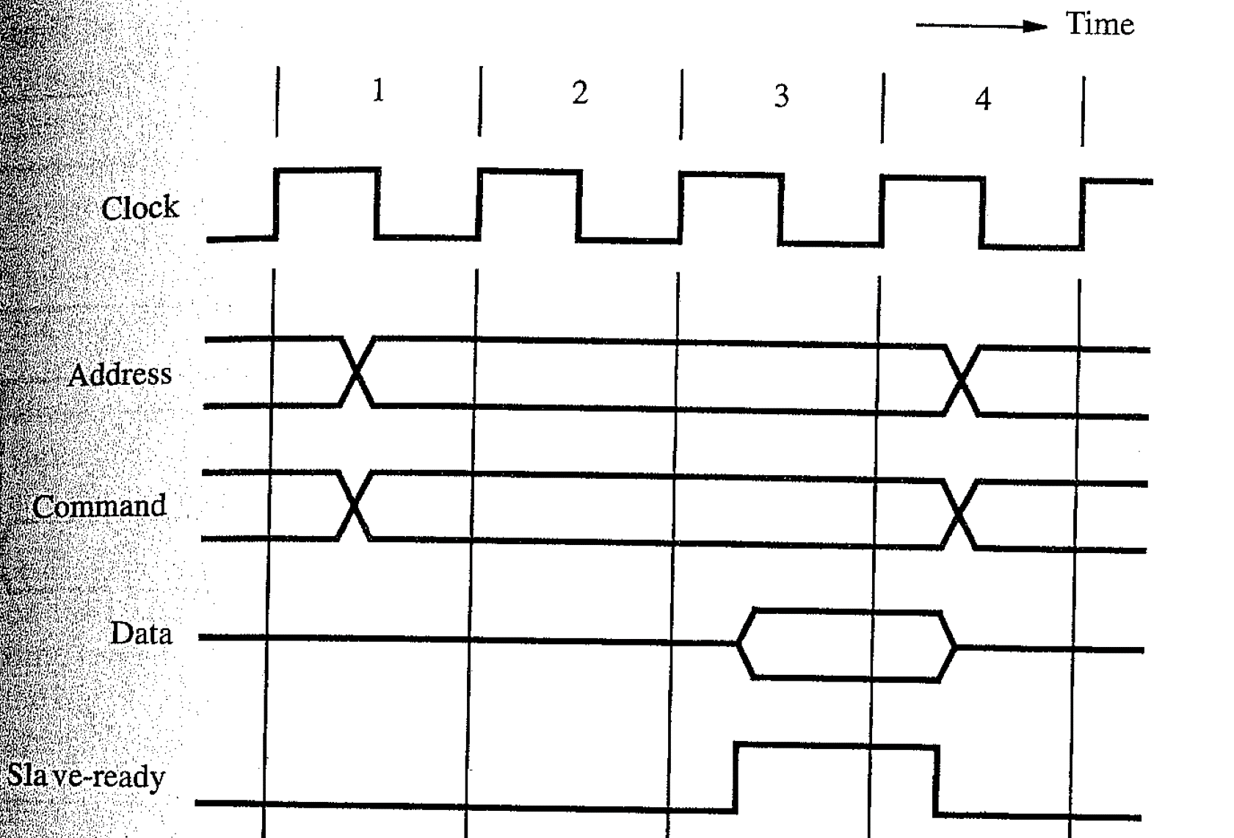
Read Operation with Multiple Cycles
1: Master places address and Read command on bus. Note the delay.
2: Slave decodes this information.
3: Slave accesses data on active edge of cycle 2.
2
3
4
5
4: Data becomes ready and placed on positive edge cycle 3.
1
5: Master sees ready signal and loads data into register at end of cycle 3
1
4
6
6: Slave removes data signals and returns Slave-ready to 0 at end of cycle 3.
4
6
Due to delay in getting data, slave cannot respond immediately.

Slide 4
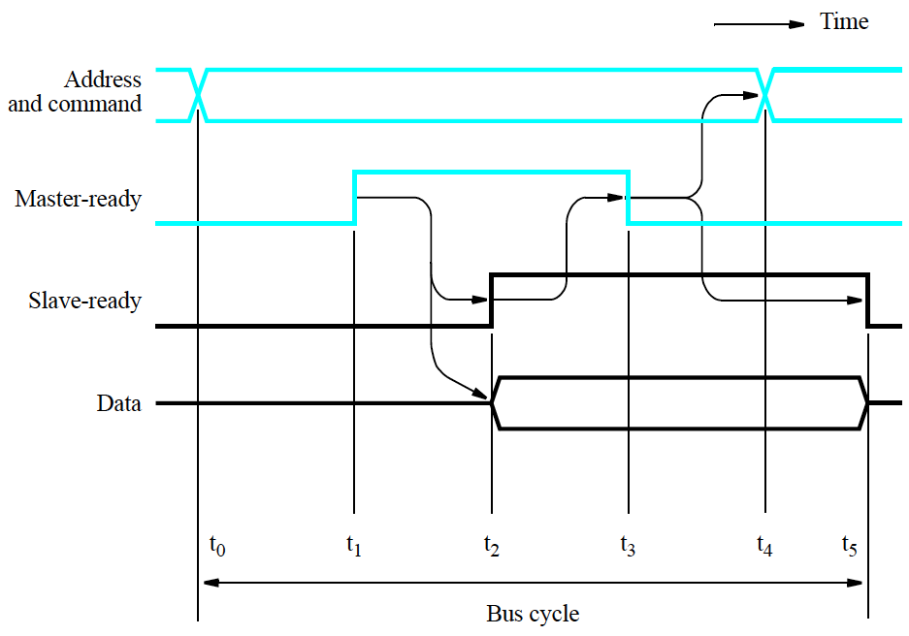
Handshake Control: Read Operation
1: Master places address and command on bus
2: Master sets Master-ready line to 1. t1 – t0 > bus skew => ensures ready signal does not arrive before address/command; Slaves decode
5: Master removes address and command from bus. t4-t3>bus skew.
3: Having decoded the address and command, slave performs operation and places data on bus. Slave-ready is set to 1.
1
5
4: Slave-ready signal arrives at master. Master loads data into register. Master drops Master-ready signal.
2
4
3
6
6: Slave received Master-ready 1-0 signal transition. Slave pulls down Slave-ready signal
3

Slide 5
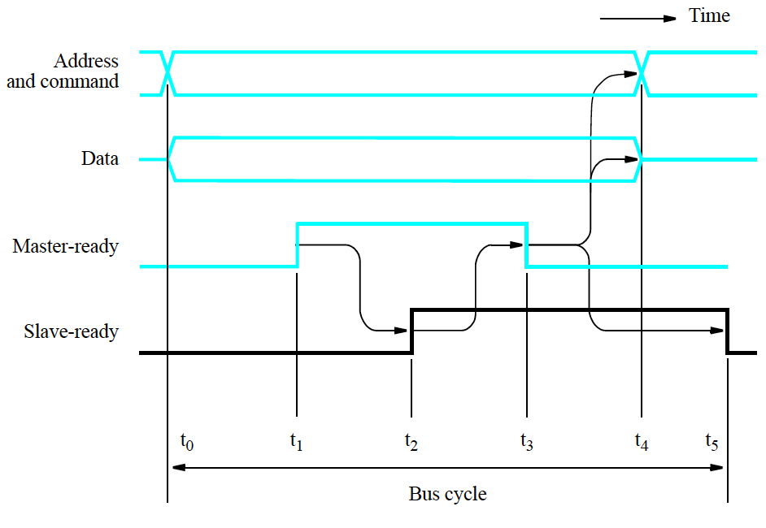
Handshake Protocol: Write Operation
1: Master places address and command (write) on bus
2: Master asserts Master-ready signal to indicate data and address valid. All devices on bus decode this.
1
1
3: Slave reads data from bus into register, and asserts Slave-ready to indicate it has done so.
2
4
3
5
4: Master sees Slave-ready signal and pulls down Master-ready.
5: Slave device sees 1-0 transition on Master-ready and pulls down Slave-ready

Slide 6
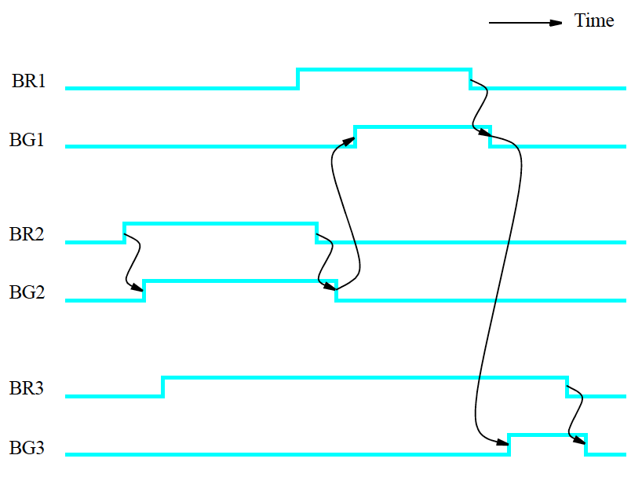
Centralized Bus Arbitration
1: Master 2 requests access to bus and is granted it since no other master is requesting it.
2
2: Master 1, 3 requests access to bus while 2 still has the bus.
3
3: Master 1 is granted bus access before 3 because it has higher priority after 2 finishes. Notice that no pre-emption is allowed here.
1
3: Master 3 is granted bus access after 1 finishes.
2
4

Slide 7
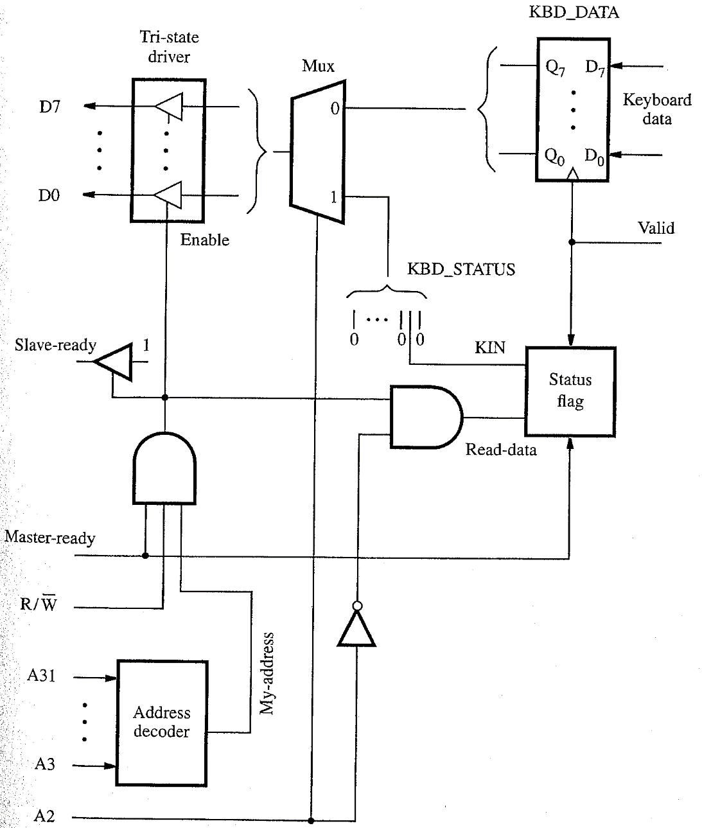
Keyboard Interface: Possible Implementation
4: If A2=0, Read-data is asserted.
5
3: Output connected to bus through a set of tri-state gates. Turned on, only when Master-ready, My-address, and R/W are 1. Slave-ready asserted too.
3
2
5
2: A2 determines which register is involved in operation. Mux selects the appropriate register output.
3
4
Address decoder examines bits A31-A3. A1,A0 not used because word aligned addresses.
1: Processor sends register address on address line on a Read.
1
5: Keyboard input – parallel data, and sets Valid on new character.
2
Notice that this is a parallel port interface.

Slide 8
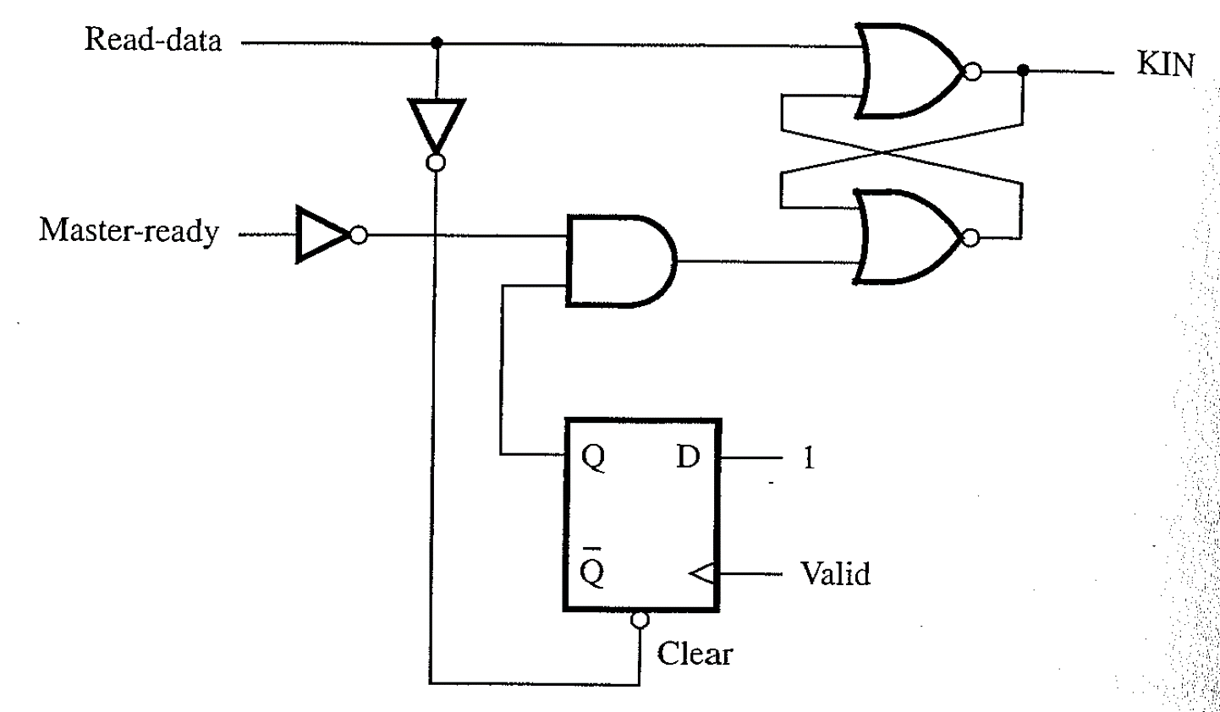
Status Flag Circuitry
4
2
1: FF gets the value 1 when at positive edge of Valid. So output is 1.
3
2: KIN is set to 1 when Master-ready is low to make sure that KIN does not change state while being read by the processor.
3: Notice that this is a circuit implementation of a latch.
1
4: When Read-data is 1, FF is cleared, and latch sets KIN to 0

Slide 9
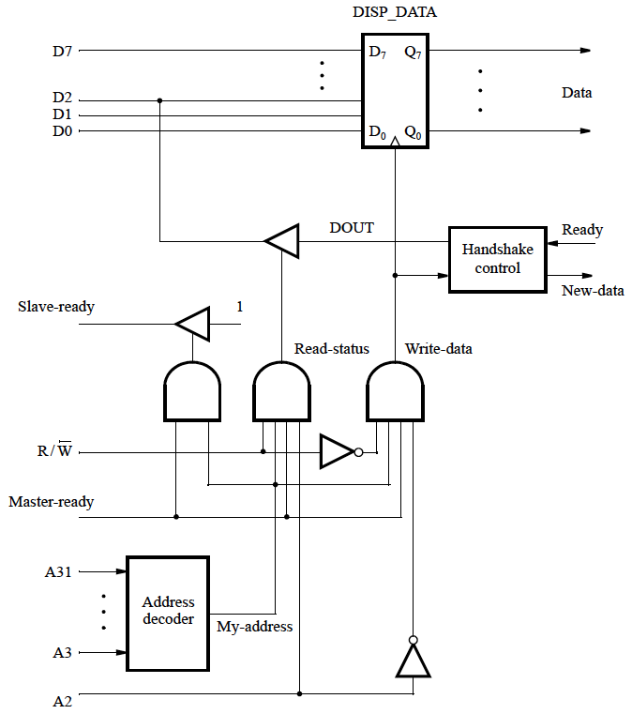
Display Output Circuitry
1: Read operation
A2 =1, read the contents of register DISP_STATUS. This example, only the DOUT bit
2
3
2: Write operation
A2 =0, load byte of data into DISP_DATA
1
3: Notice the parallel port interface again.

Slide 10
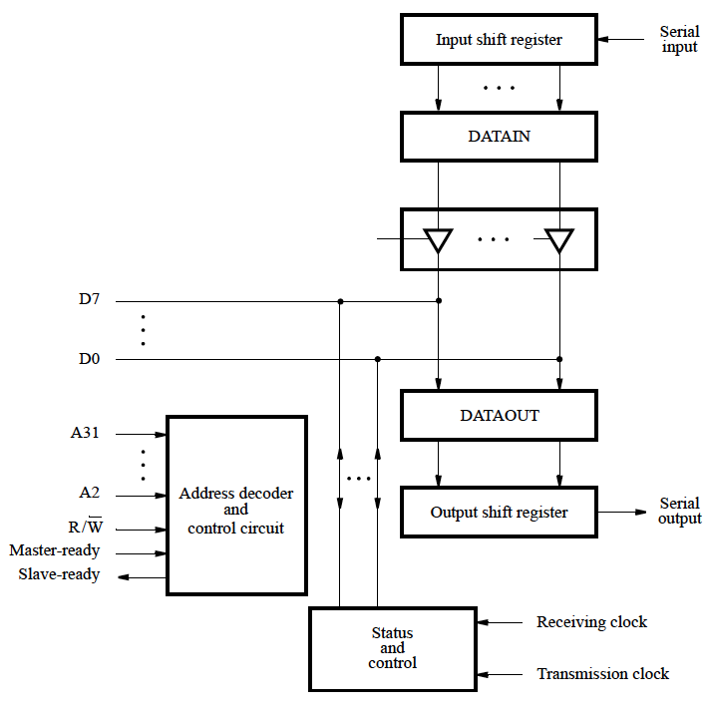
Serial Interface: UART Example
1: Accepts bit-serial input from UART. When all 8 bits received, contents of shift register loaded in parallel into DATIN.
1
1
2: Similar with output. DATAOUT loaded in parallel into shift register.
3: Assume SIN and SOUT are in Status and Control block.
SIN=1, new data loaded in DATAIN from shift register.
SIN=0, data read by processor.
SOUT=0, processor writes data into DATAOUT.
SOUT=1, transfer to shift register.
2
2
3

Slide 11
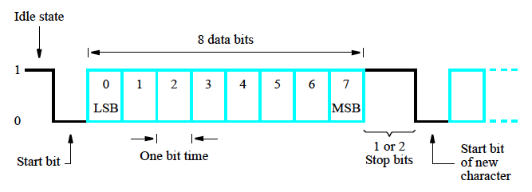
Asynchronous Transmission
Start-stop transmission
  Data organized in groups (8 bits)
  Transmitter sends a start signal, then sends data, and then stop signal
1: Idle when in 1 state.
1
2: Start bit of 0 sent to signal start of transmission. Alerts receiver transmission is about to start. Using known baud rate, receiver computes position of next 8 bits.
3
2
3: Stop bits: 1 or 2 “1” value sent to indicate termination of 8 bits.
Line remains in state 1 (idle) after termination.

Slide 12
PCI Read Operation
Clock Cycle 1
Clock Cycle 2
Clock Cycle 3
Clock Cycle 4
Clock Cycle 5
Clock Cycle 6
Clock Cycle 7
1
2
CLK
4
FRAME#
AD
3
Address
Data #1
Data #2
Data #3
Data #4
C/BE#
Command
Byte Enable
IRDY#
2
4
TRDY#
3
4
2
DEVSEL#
4
1: Read operation
Initiator asserts FRAME# in c1 to start transaction. Places address on AD and command on C/BE# (Read, Memory address space)
2: Initiator removes address, disconnects drivers from AD, asserts IRDY# saying its ready to receive. DEVSEL# asserted to indicate target recognized address and ready to respond.
3: TRDY# asserted and target starts sending data. If target has additional delays, then TRDY# can be asserted later.
4: FRAME# deasserted. Target sends one more data word in next cycle then stops. Deassert IRDY#, TRDY# and DEVSEL# in c7

